Slide 1
Budget General Assembly
February 21, 2018

Slide 2
Policy Manual
Statutes

Slide 3
Rules of the GA

Slide 4
Opening of the GA

Slide 5
Agenda
Rules of the GA
Opening of the GA
Agenda
Minutes from previous GA
Semester Report Fall 2017
Financial Report Fall 2017
Audit by the IB
Committees
Candidate Committee -Book Club
New Committee - Circus Committee
Budget Spring 2018
Questions
Closing of the GA
Drinks and Snacks

Slide 6
Minutes from the Election GA

Slide 7
Semester Report Fall 2017

Slide 8
Financial Report Fall 2017

Slide 9
Audit by IB

Slide 10
Candidate Committees
Book Club
Circus Committee

Slide 11
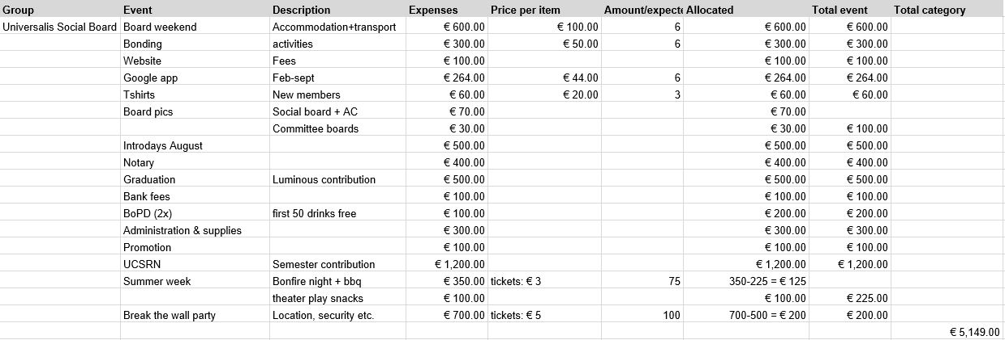
Universalis Social Board

Slide 12
FHS/MSP & UCSRN
Active Members & General Assembly

Slide 13
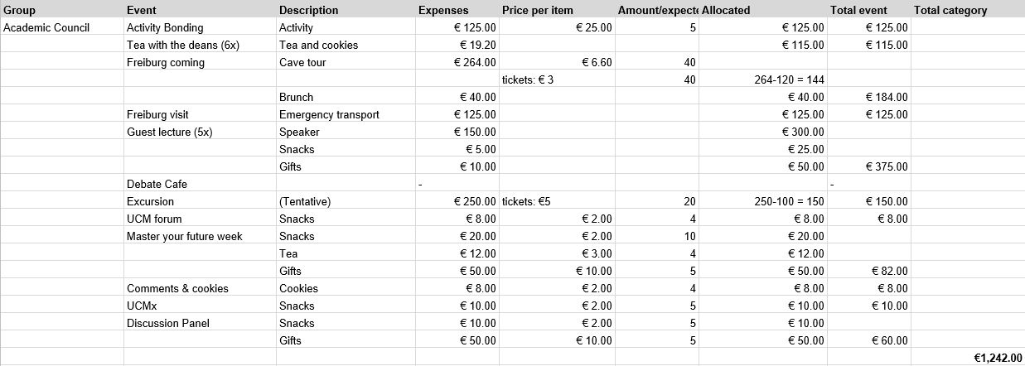
Academic Council

Slide 14
Arts & Photo

Slide 15
The Bell

Slide 16
Spiritual Enlightenment

Slide 17
Charity

Slide 18
Choir

Slide 19
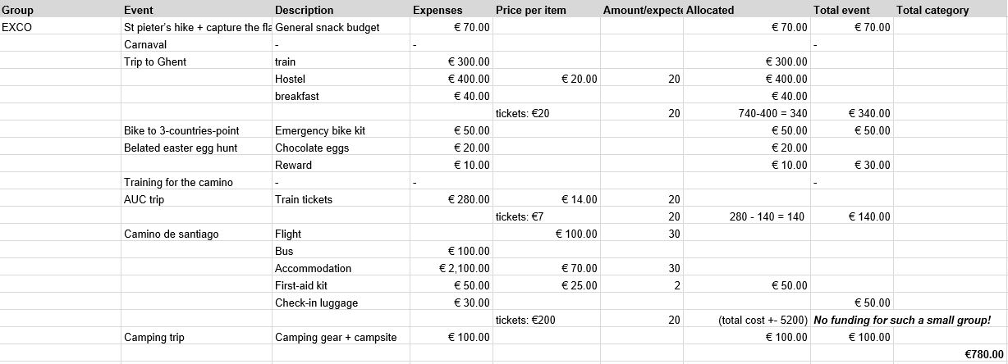
Excursion Committee

Slide 20
Feminism

Slide 21
Film

Slide 22
GECCO

Slide 23
Ludens

Slide 24
Meditation

Slide 25
Music

Slide 26
Musical

Slide 27
Party

Slide 28
Poetry

Slide 29
Sports

Slide 30
Theatre

Slide 31
Unexpected

Slide 32
Overall Budget

Slide 33
Questions?

Slide 34
Closing of the GA

Slide 35
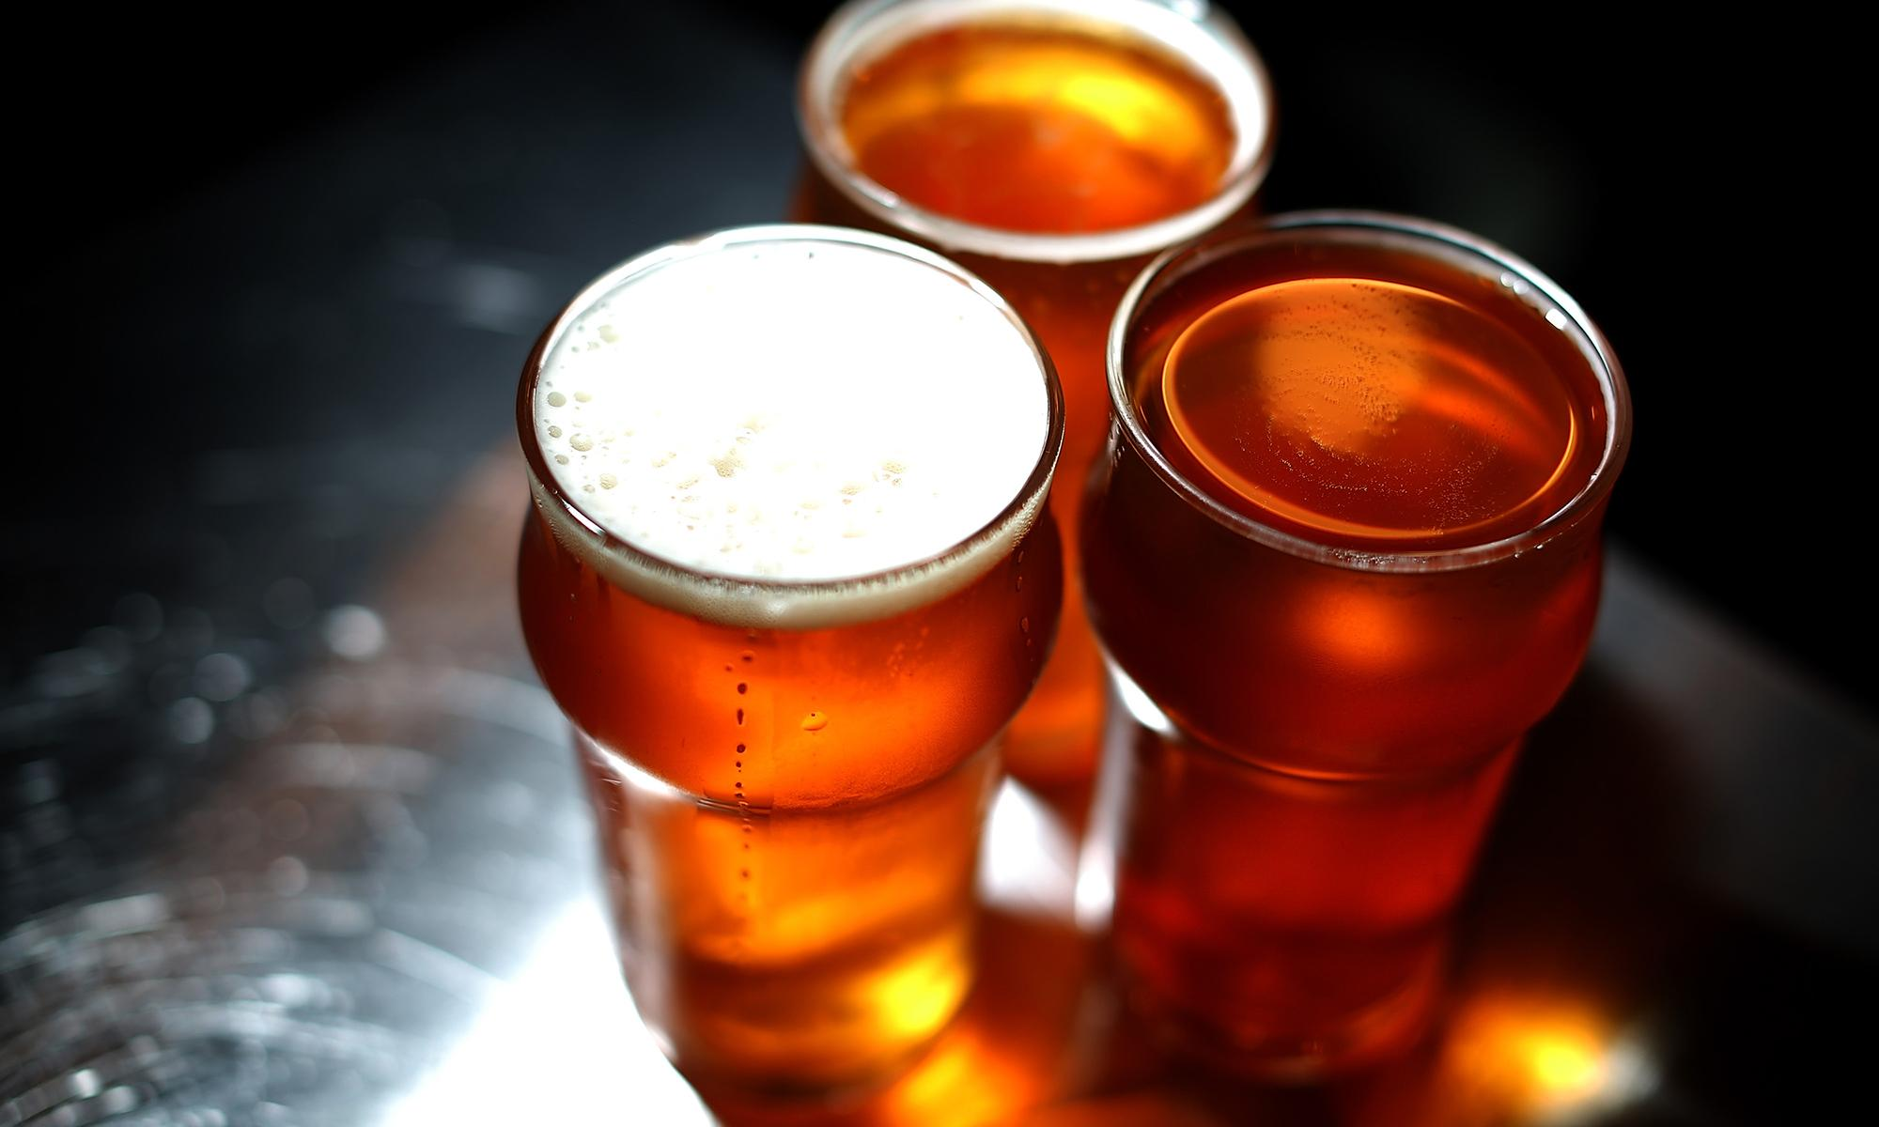
Drinks and Snacks!

