Slide 1
Election General Assembly
January 10th, 2018

Slide 2
Opening of the GA

Slide 3
Agenda
Opening of the GA
Approval of the Agenda
Academic Council
  Proposed board
  Introduction
Universalis Social Board
  Proposed board
  Introduction
Independent Body
  Proposed board
  Introduction
Voting
Film Committee
Semester plans
Questions
Closing of the GA
Snacks and drinks

Slide 4
Academic Council
Board Proposal

Slide 5
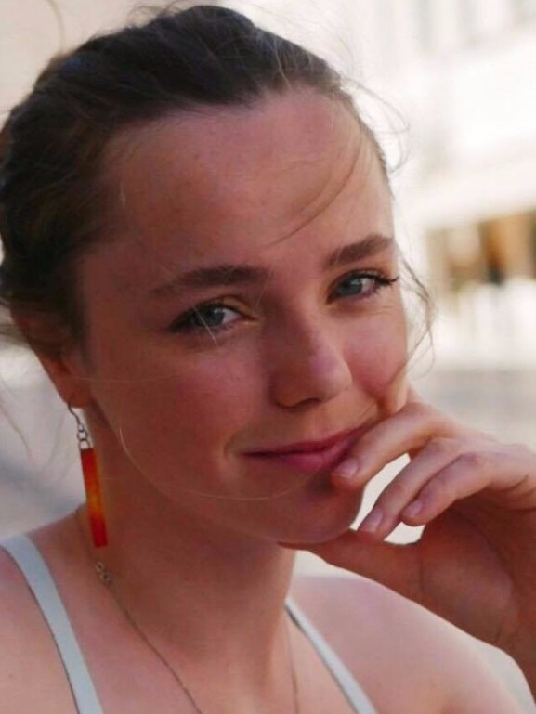
Freya Walker
Events Coordinator

Slide 6
Erick Jackaman
Internal Executive

Slide 7
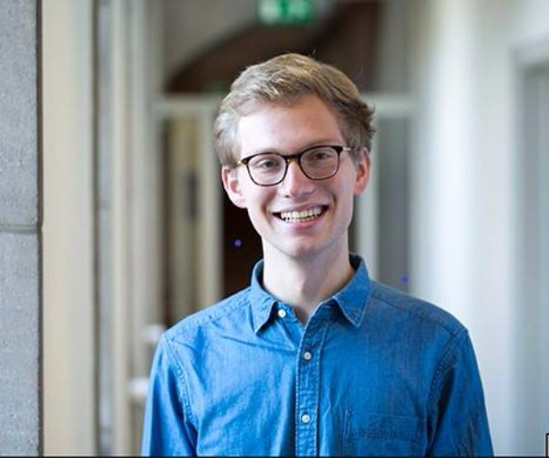
Paul Grass
Treasurer

Slide 8
Universalis Social Board
Board Proposal

Slide 9
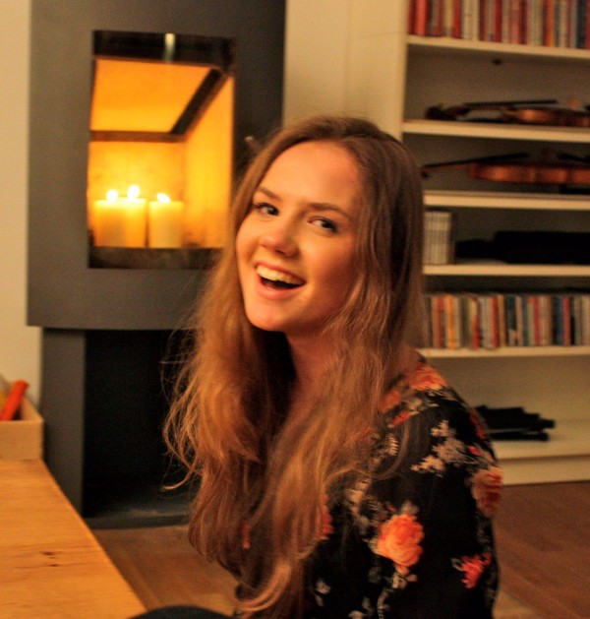
Eleanor Kelly
Acquisition Executive

Slide 10

Ruben Dominguez
Secretary

Slide 11
Independent Body
Board Proposal

Slide 12
Nina Hanz

Slide 13
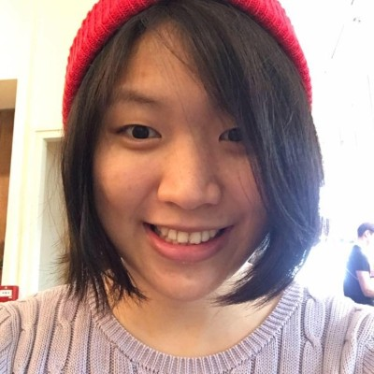
Chih-Hsi Hu

Slide 14
Thilo Buchholz

Slide 15
Please vote now!

Slide 16
Film Committee

Slide 17
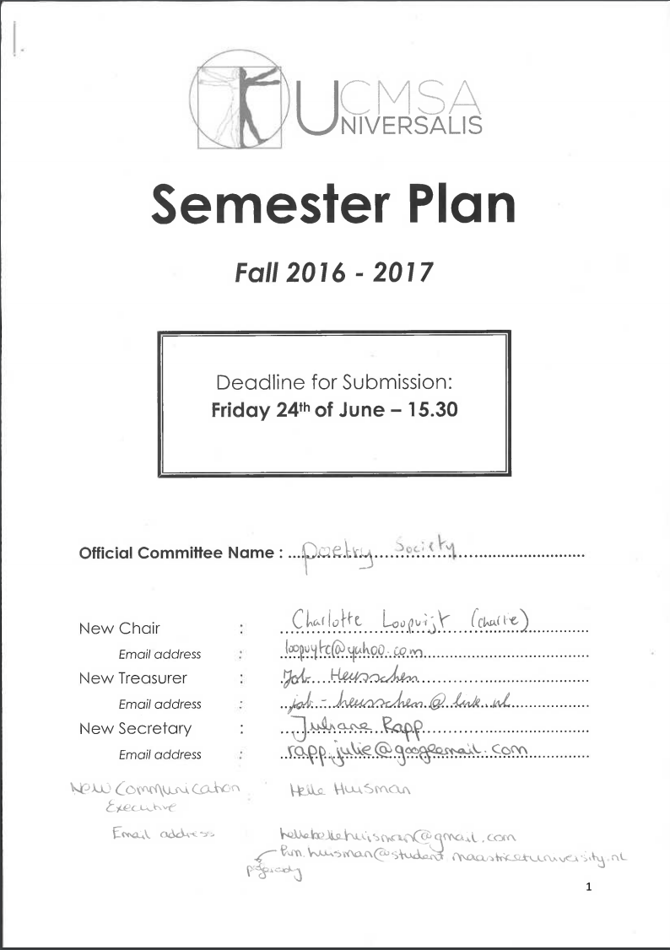
Semester Plans
Deadline: Wednesday in Week 3
New boards
Ideal semester plan
Transition bibles

Slide 18
Questions?

Slide 19
Closing of the GA

