Slide 1
Budget GA
Tuesday, September 15th, 2020

Slide 2
Rules of the GA
By the Independent Body

Slide 3
Rules of the GA
VOTING
Polling in Zoom
QUESTIONS
Raise hand function
TECHNICAL POINTS
Press the yes button (✅)

Slide 4
Opening of the GA

Slide 5
Agenda
Opening of the GA
Approval of the Agenda
Approval of Minutes from the last GA
Announcements
GA Chair updates
Treasurer updates
Presentation of the Fall 2020 Budget
10-minute break
Presentation of extra motions
Open floor and questions
Closing of the GA
Drinks!

Slide 6
Approval of the Agenda

Slide 7
Minutes from previous GA

Slide 8
Announcements
GA Chair Updates:
Covid-19 and Universalis update
Logo Update
Treasurer Announcements:
Financial Report
Budget Update
Bank Account

Slide 9
Non-member vote-in

Slide 10
Budget Allocation Fall 2020

Slide 11
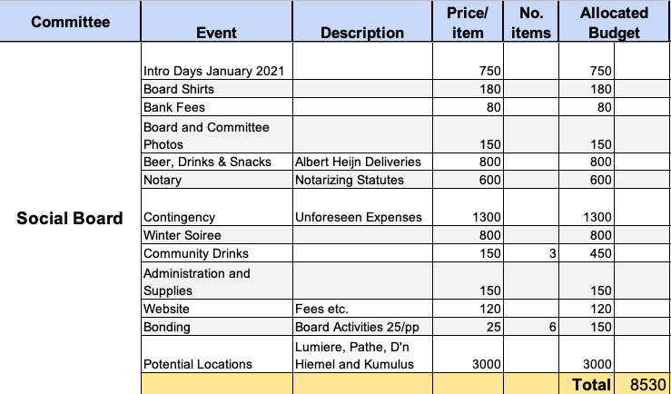
Social Board

Slide 12
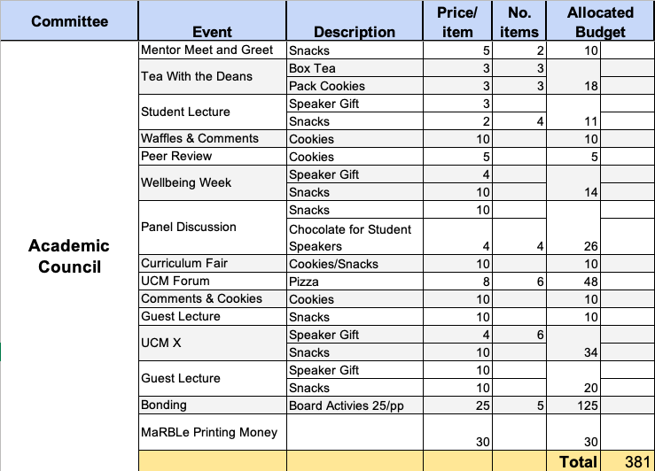
Academic Council

Slide 13
UCSRN

Slide 14
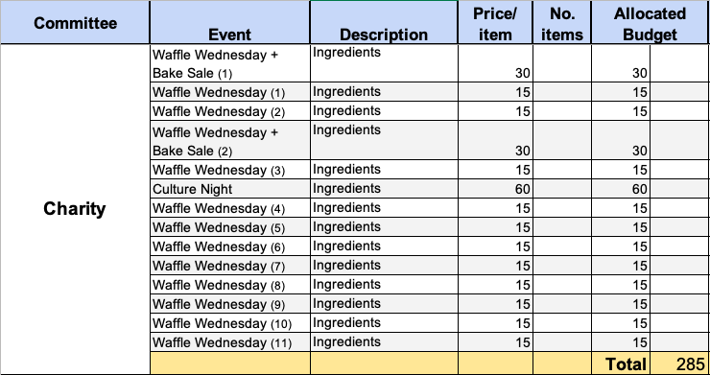
Charity

Slide 15
Charity Motion

Slide 16
GECCO

Slide 17
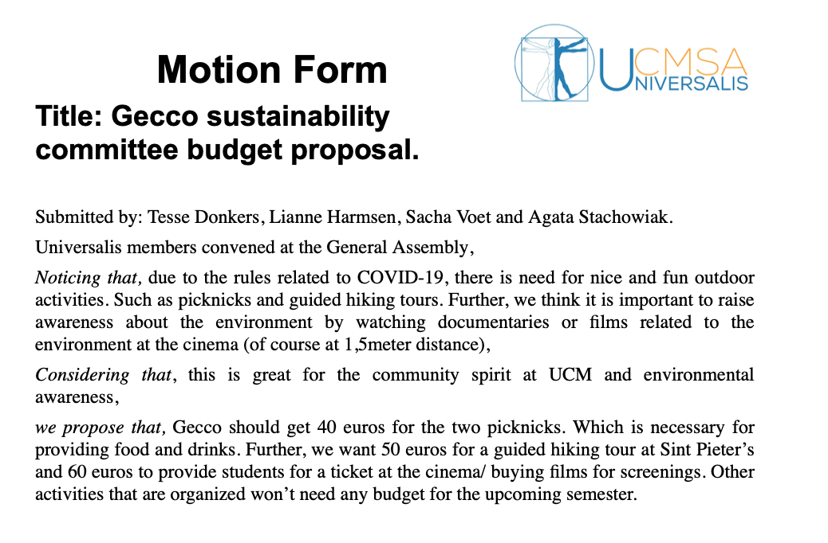
GECCO Motion

Slide 18
Ludens

Slide 19
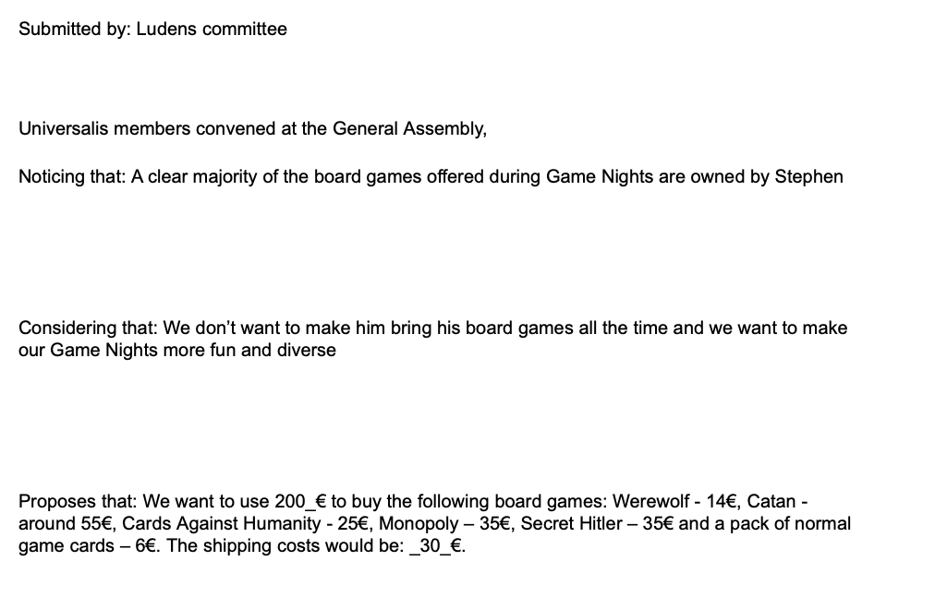
Ludens motion

Slide 20
10 Minute Break

Slide 21
Music

Slide 22
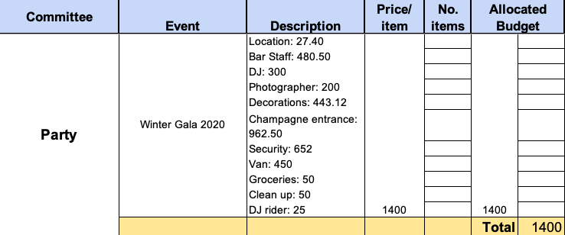
Party

Slide 23
Party Motion
Comments from the Treasurer

Slide 24
The Bell

Slide 25
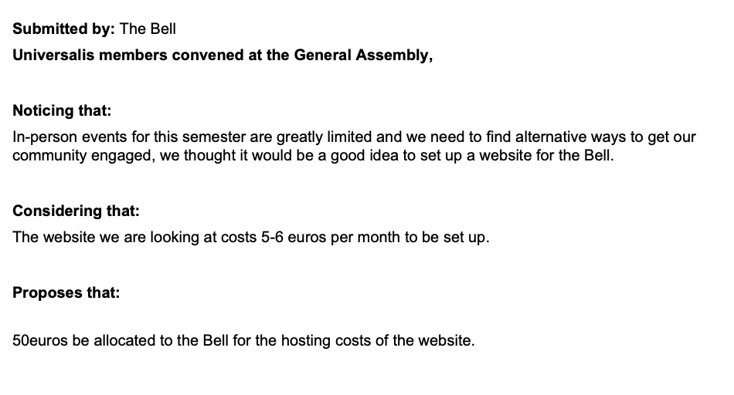
The Bell Motion

Slide 26
Wellbeing

Slide 27
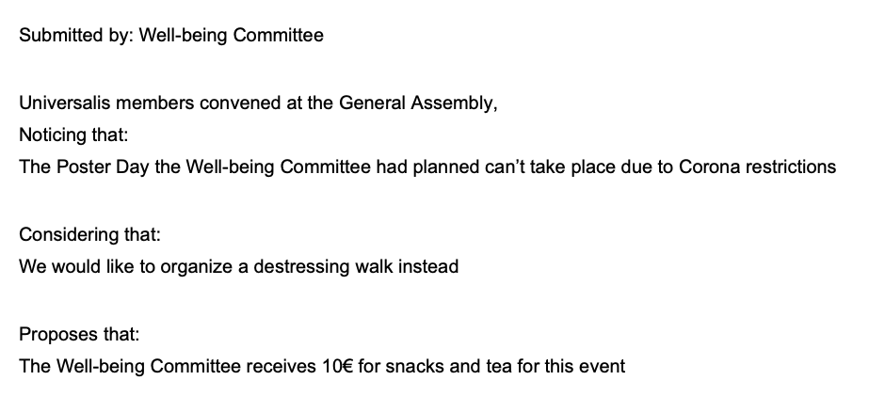
Wellbeing motion (1)

Slide 28
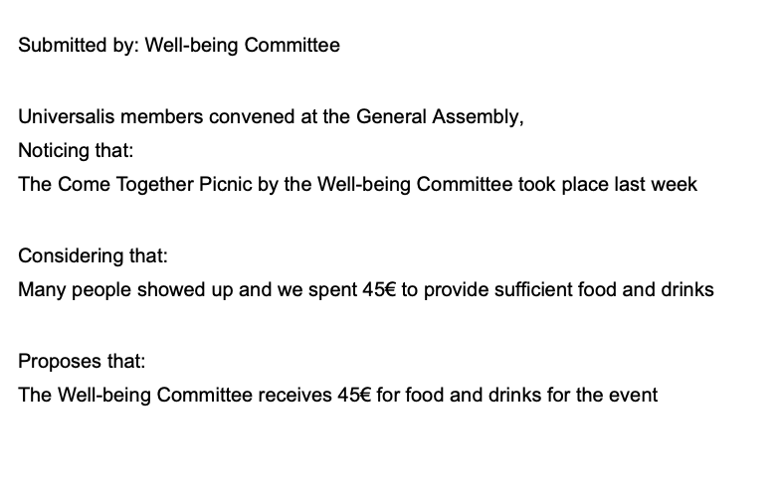
Wellbeing motion (2)
Comments from the Treasurer

Slide 29
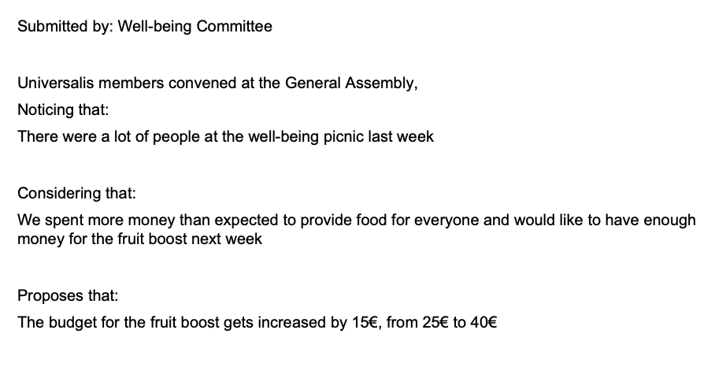
Wellbeing motion (3)
Comments from the Treasurer

Slide 30
Archeion

Slide 31
Archieon motion

Slide 32
Latin American Perspectives

Slide 33
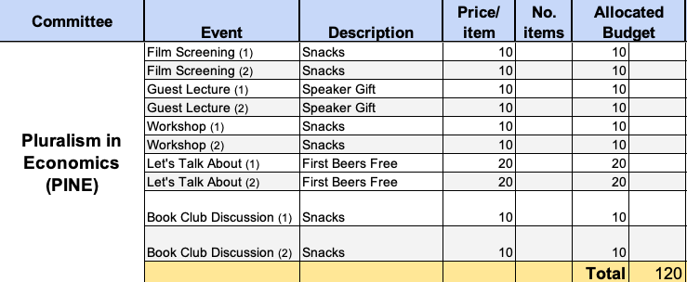
Pluralism in Economics (PINE)

Slide 34
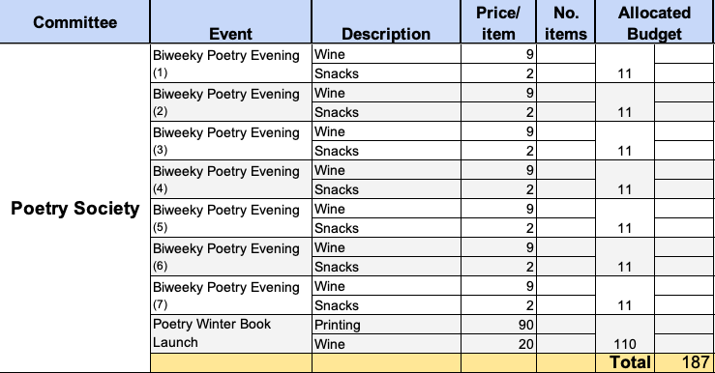
Poetry Society

Slide 35
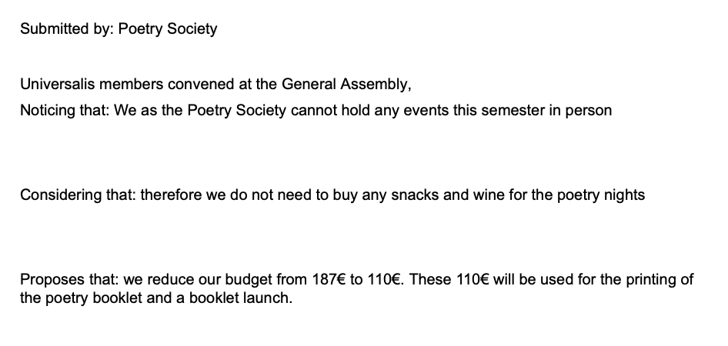
Poetry motion

Slide 36
Spiritual Enlightenment

Slide 37
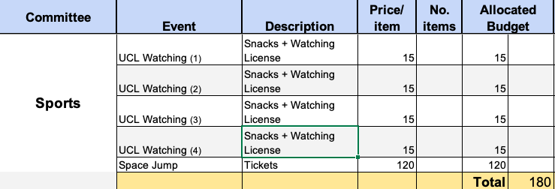
Sports

Slide 38
Theatre Society

Slide 39
Book Club

Slide 40
DANCE VERSITY

Slide 41
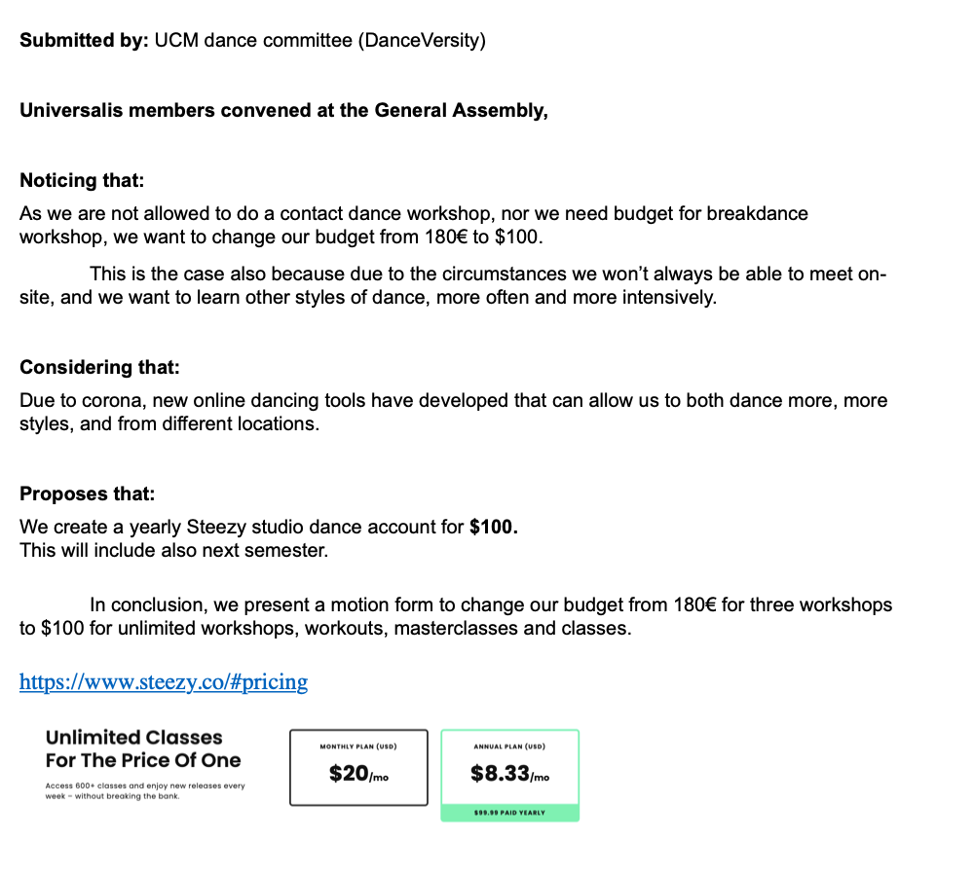
Danceversity

Slide 42
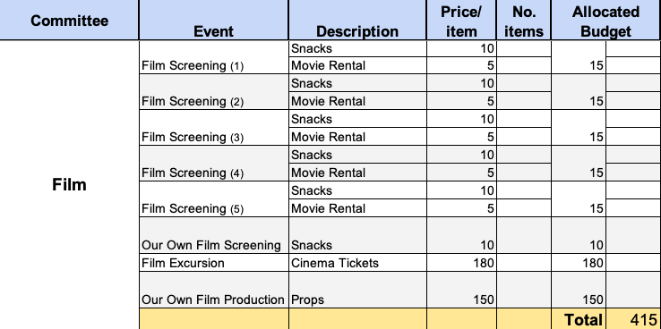
Film

Slide 43
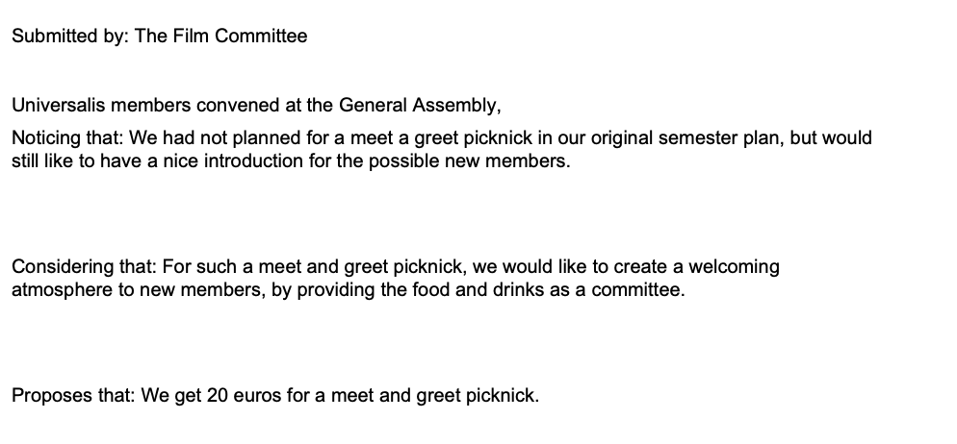
Film motion (1)

Slide 44
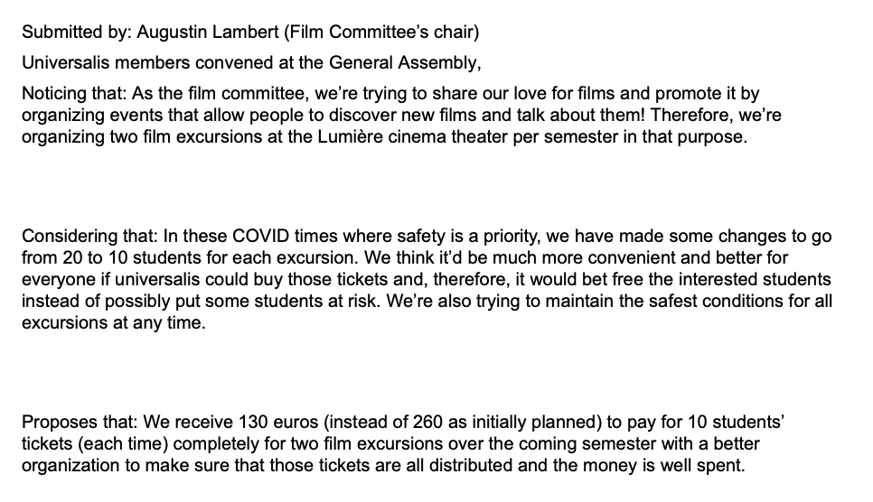
Film motion (2)

Slide 45
Film motion (3)

Slide 46
Meditation

Slide 47
Musical Theatre Society

Slide 48
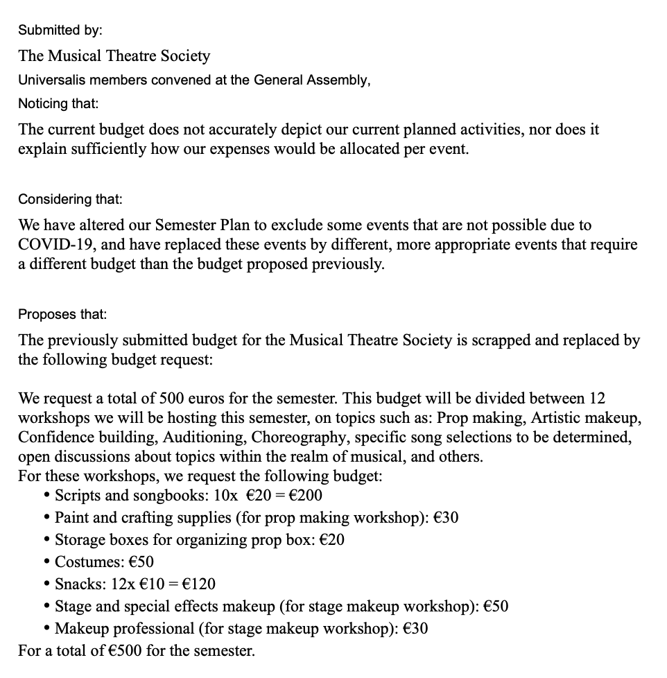
MTS motion

Slide 49
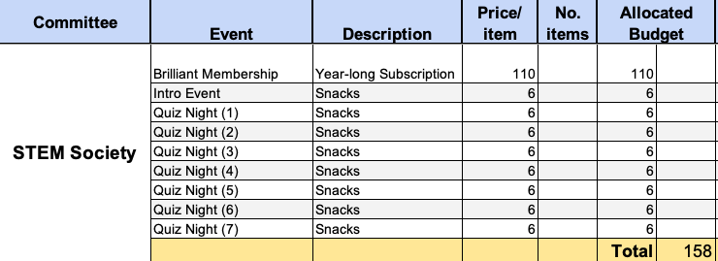
STEM Society

Slide 50
Hypatia

Slide 51
Presentation of Extra Motions

Slide 52
Final Count

Slide 53
*Screenshot of Income/Budget*

Slide 54
Passing the Budget

Slide 55
Open Floor and Questions

Slide 56
Closing of the GA

Slide 57
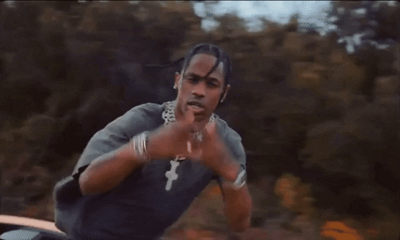
Drinks!

