Slide 1
Election & Surplus
General Assembly Spring 2022
Wednesday, January 19th 2022

Slide 2
Rules of the GA
By the Independent Body

Slide 3
Rules of the GA - General Assembly Chair
Chaired by the President of the UCMSA Universalis Board
•In absence the Vice-President or another member of the UCMSA Universalis Board chairs the G.A. (Statutes 13.1)
•The G.A. may appoint any member to serve in place of the President (PM 3.6.10.i g)
The Chair of the G.A.
•Opens and closes the G.A.
•Sets the parameters for debate, and grants members the right to speak, with due consideration for all positions (PM 3.6.7. v)
•Casts the deciding vote in election procedures where two candidates reach equal votes after two rounds of voting (Statutes 12.5)
•States the result of the voting, which is final so long as no member of the G.A. objects to the chair’s judgment (Statutes 13.2)

Slide 4
Rules of the GA - Minutes
The Secretary of the UCMSA Universalis Board shall take minutes
•The chairperson can designate another minute taker or the G.A. can request a change of the minute taker (Statutes 13.3 & Policy Manual 3.6.10.i h)
Any member may motion at anytime to change the Chair and/or Notetaker of the GA, to do so make at –| with both hands, the motion will then be debated (PM 3.6.9.i g-h)

Slide 5
Rules of the GA - Discussion
•The chairperson of the general assembly gives the right to speech to members. (Policy Manual Article 3.6.7.v)
•Before the discussion of a motion the chairperson sets a time-limit and/or a limit of speakers for the discussion. (Policy Manual Article 3.6.7.v)
Any member may motion at anytime to: expand, end, move to a vote, postpone or shorten any discussion; they may also pause the GA (PM 3.6.9.i a-e), to do so make at –| with both hands
•The chairperson shall make sure that all positions are represented with equal weight (Policy Manual Article 3.6.7.v)
•The chairperson has the right to stop a speech should it be purposefully offensive or disruptive to the general assembly (Policy Manual Article 3.6.7.v)

Slide 6
Rules of the GA - Motions
•Motions must be filed before the GA
•Most must be submitted within time limits set in PM 3.6.4 & 6
•Motions to dismiss any Board, AC or IB member must be filed at least one week before the GA (PM 5.13)
•Motions to amend constituting documents must be published in full text 5 days before a GA which is explicitly called for the purpose of amending the documents (Statues 17.1 with a proviso for 17.5)

Slide 7
Rules of the GA - Ad Hoc Motions
Ad hoc motions (PM 3.6.6.iv)
•Ad hoc motions can be put forward at any time during the G.A.
•Ad hoc motions can only contain changes to an already proposed motion
•The original motion must be accepted for debate by the GA before the ad hoc may be considered
Procedural Motions (PM 3.6.9.i)
•Change anything about the course of the GA, including officers, within limits set by the statutes and PM, raise your hands in a –| formation to announce this
Motions to Amend the Agenda (PM 3.6.6.iii)

Slide 8
Rules of the GA - Procedural Motions
•The person putting forward the procedural motion has the right to argument in favour of their point for one minute.
•Following this any other member might argue against the procedure change for one minute.
•After that the procedural motion shall be voted upon, with an absolute majority needed for it to pass.
•If there is no one to hold the counter speech the motion passes automatically, so long as no vote is specifically requested by a member of the general assembly.

Slide 9
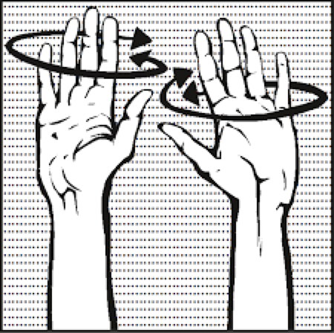
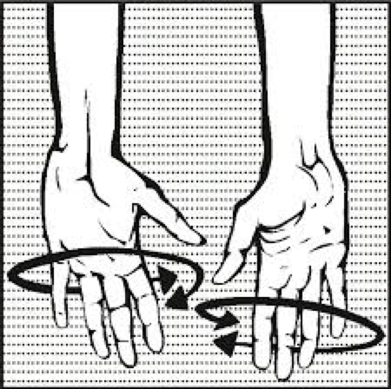
Rules of the GA - Technical Point
If you agree with something,
waive your hands like this:
If you disagree with something, waive your hands like this:

Slide 10
Rules of the GA - Voting Procedure
•Each member has a single vote (Statutes 12.2)
•The President of the UCMSA Universalis Board shall determine the voting procedure (Statutes Article 12.4)
•Decisions are taken by an absolute majority (Statutes Article 12.5, PM 3.6.7.i), except where specified differently by Dutch Law the Statutes, or PM
•Voting in general is open, however elections are held by secret ballot
•For any vote a member of the G.A. can request a secret ballot, which is followed if at least 10% of attending members vote in favour of the request (Policy Manual Article 3.6.7.vi)

Slide 11
Rules of the GA - Proxies for absent members
•An absent member can vote if they provide a written proxy to an attending member. The written proxy must be cast prior to the opening of the G.A. (Policy Manual 3.6.7.ii)
•An attending member can function as a proxy for a maximum of two absent members (Statutes 12.2)

Slide 12
Rules of the GA - Quorum
•If the attendance of the G.A. drops below 2/3s of the initially present members the G.A. ceases to be quorate (Policy Manual 3.6.7.iii)
•Any member can request a count of present members. The chairperson has three minutes to call members to reenterthe general assembly before the count takes place. (Policy Manual 3.6.7.iv)

Slide 13
Opening of the GA

Slide 14
Agenda
Rules of the GA
Opening of the GA
Approval of the Agenda
Approval of Minutes from Fall 2021 Budget General Assembly
Status of the Spring 2021 Financial Report
6. Elections
Confirmation of Chair Vote
Candidates for
Secretary
Treasurer
Social Internal
Social External
INDEPENDENT BODY*
7. Stop-Gap Budget
8. Open Floor & Questions
9. Closing of the GA
Notes:
It was mistakenly left out of the Agenda.

Slide 15
Minutes from previous GA
Notes:
NOTICE THAT, CONSIDERING THE OPINION FROM THE PREVIOUS GA AND ADVIE FROM A LEGAL ADVISOR, THE WAY WE ARE TAKING MINUTES HAS CHANGED.

Slide 16
Status: Spring 2021 Financial Report
Notes:
NOTICE THAT, CONSIDERING THE OPINION FROM THE PREVIOUS GA AND ADVIE FROM A LEGAL ADVISOR, THE WAY WE ARE TAKING MINUTES HAS CHANGED.

Slide 17
Chair Elections
Confirmation of vote

Slide 18
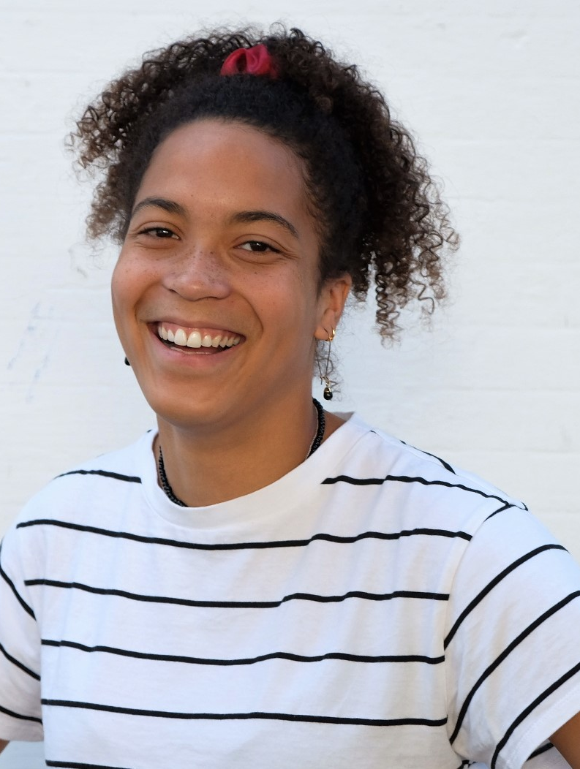
Confirmation for Social Chair Vote
Beatrix Bridge

Slide 19
Board Elections

Slide 20
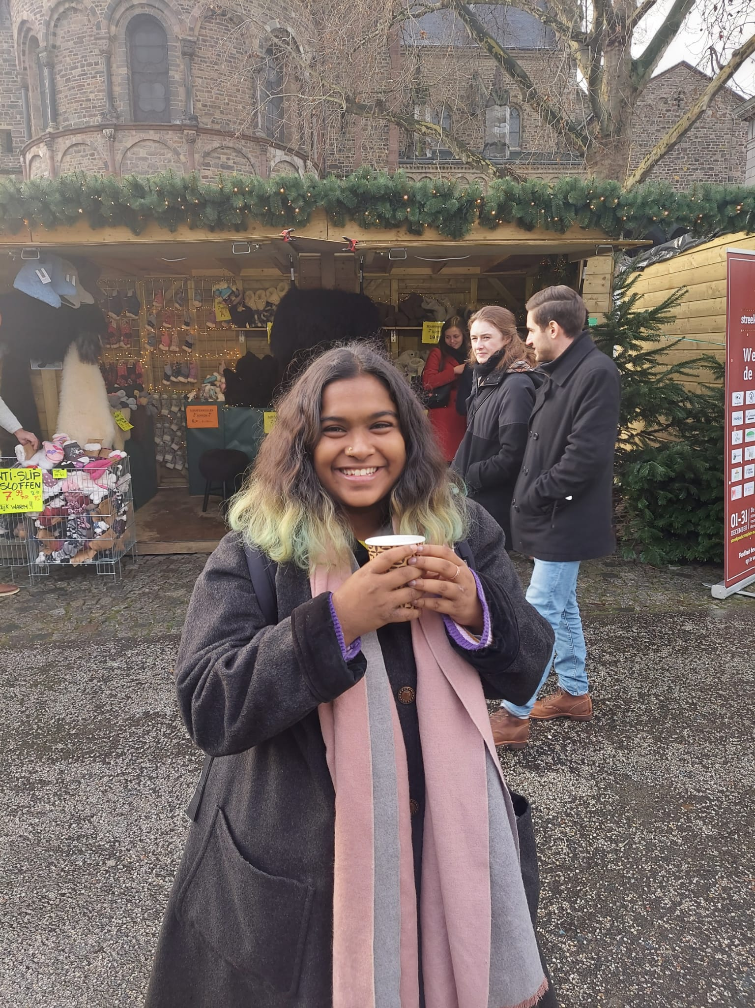
Candidate(s) for Secretary
Mrignayani Dasgupta

Slide 21
Candidate(s) for Treasurer
Salomé Carrillat

Slide 22
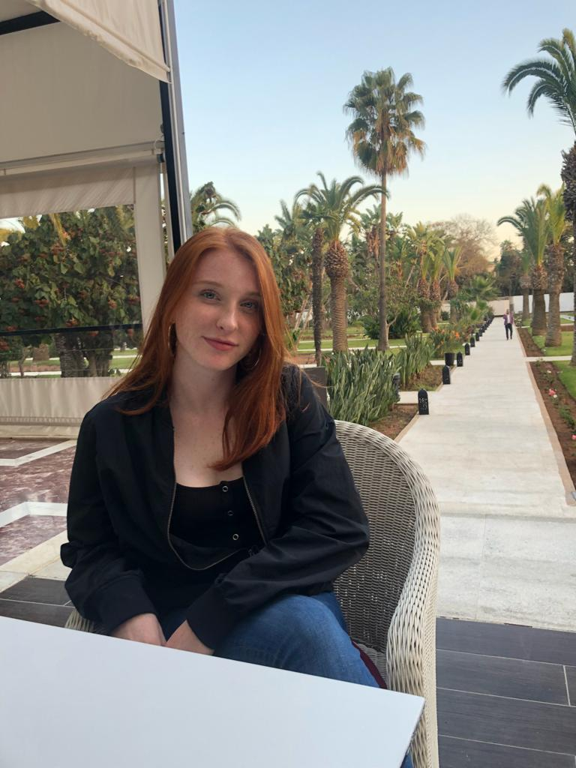
Candidate(s) for Social Internal
Yulianna Nuno

Slide 23
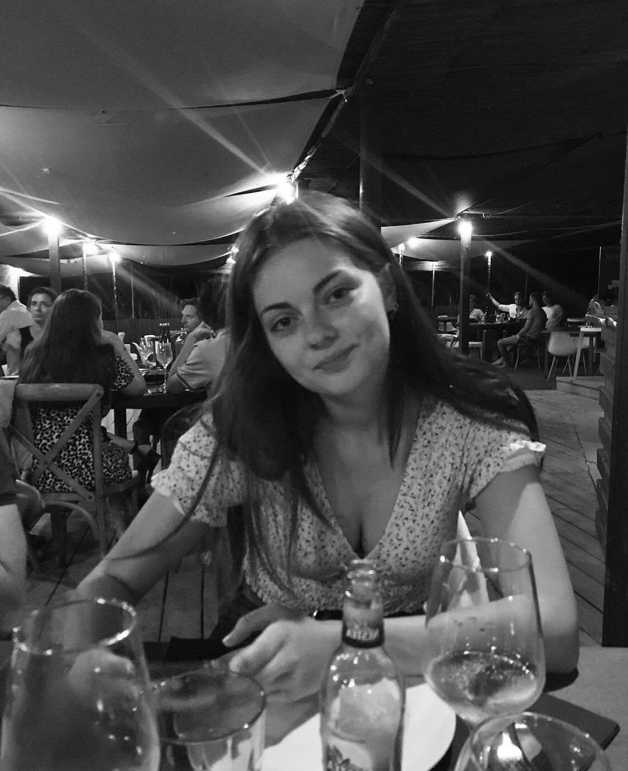
Candidate(s) for Social External
Juliette Breda

Slide 24
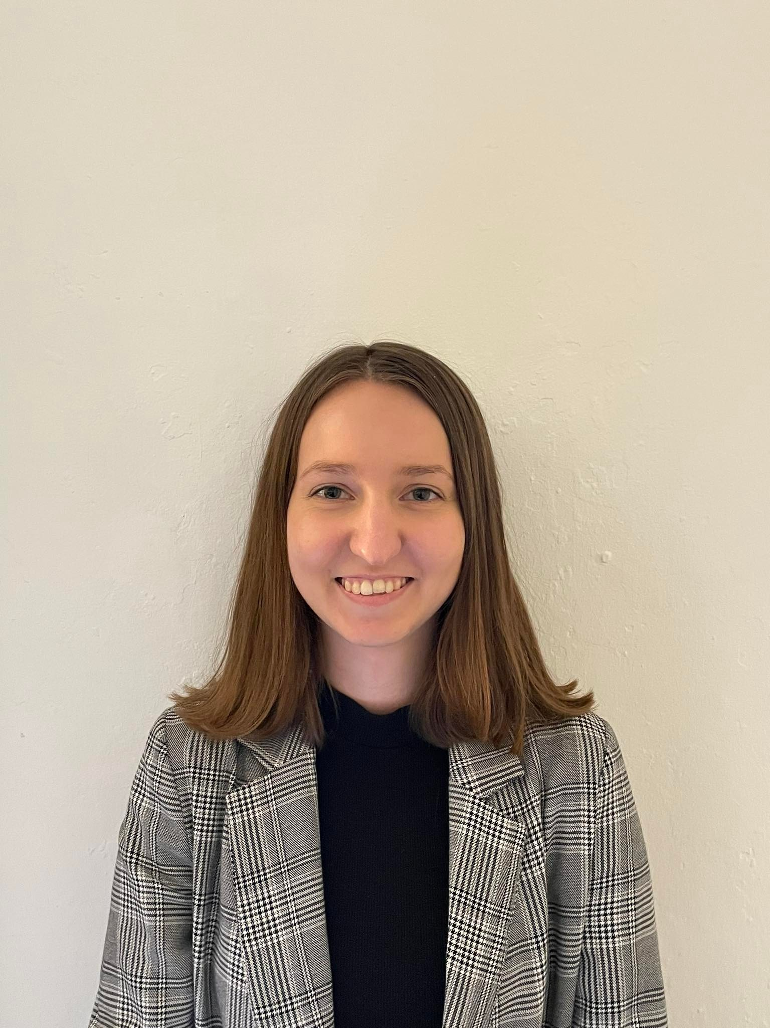
Candidate(s) for INDEPENDENT BODY
Lily Pepper

Slide 25
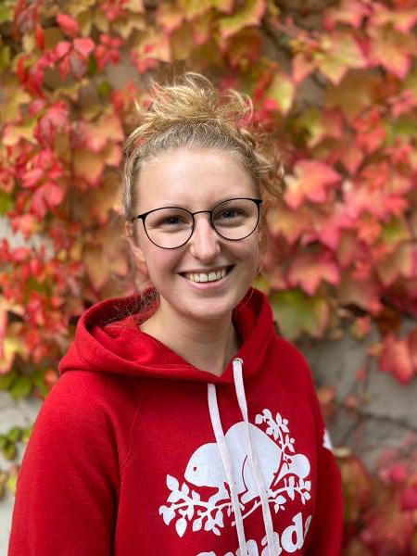
Candidate(s) for INDEPENDENT BODY
Maire Sauerbrei

Slide 26
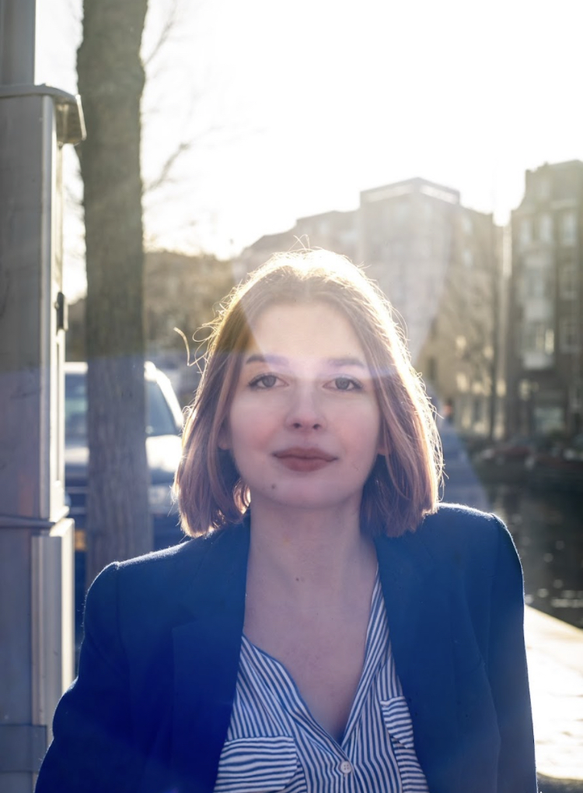
Candidate(s) for INDEPENDENT BODY
Rose Cooper

Slide 27
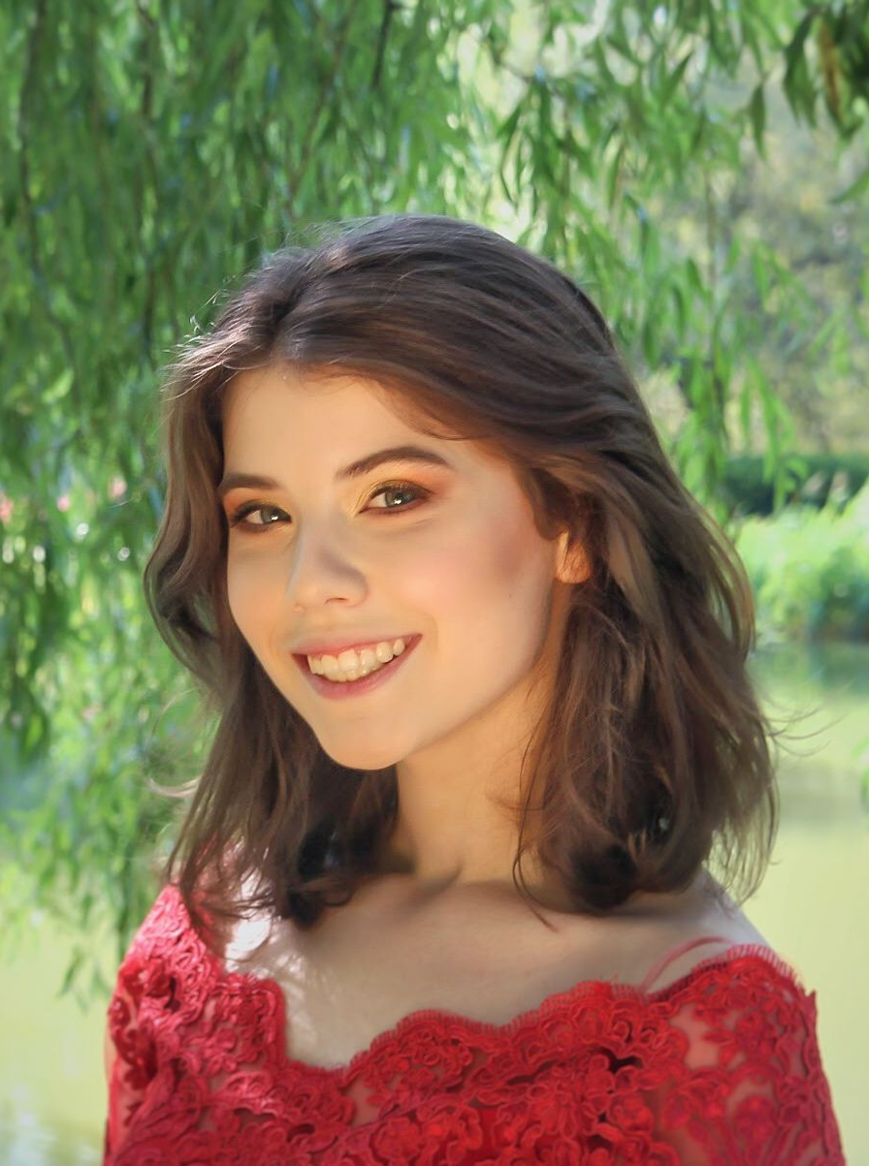
Candidate(s) for INDEPENDENT BODY
Karolina Kisiel

Slide 28
Break

Slide 29
Budgetary Motion Forms

Slide 30
Surplus Motions

Slide 31
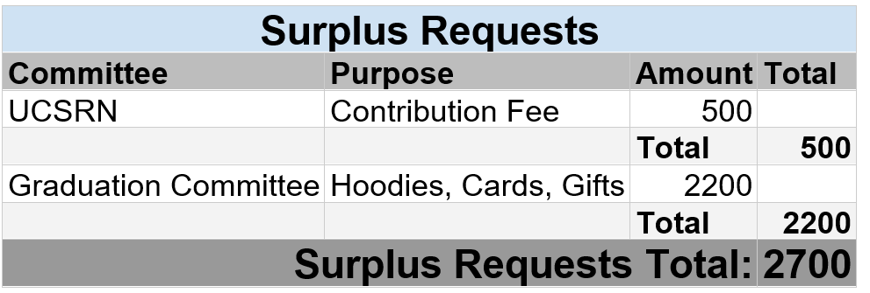
Spring 2022 - Surplus Requests

Slide 32
Stopgap Motions

Slide 33
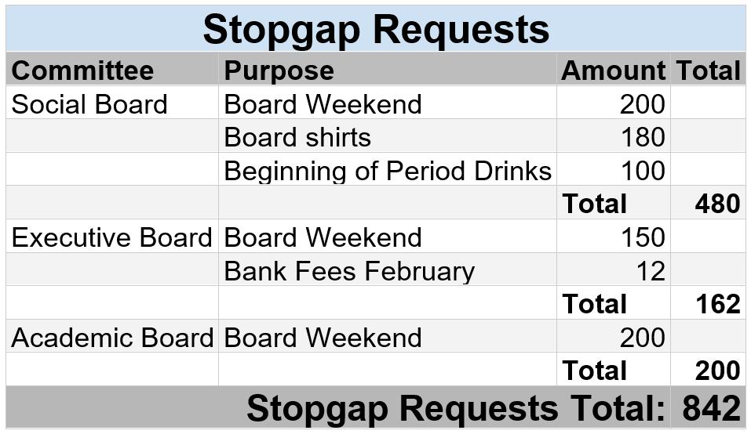
Spring 2022 - STOPGAP Requests

Slide 34
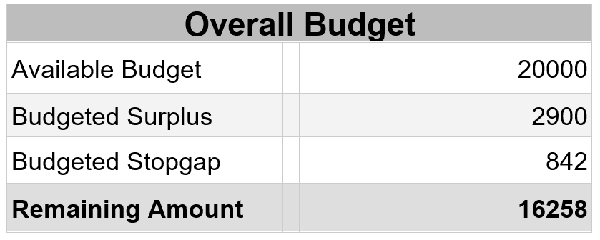

Slide 35
Ad-hoc Motions?

Slide 36
Final
Surplus/Stopgap Budget Vote

Slide 37
Open Floor – Questions?

Slide 38
Closing of the GA

Slide 39
Drinks and snacks!

